Slide 1
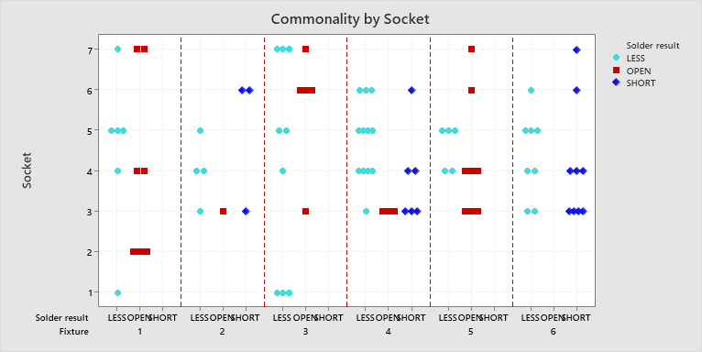
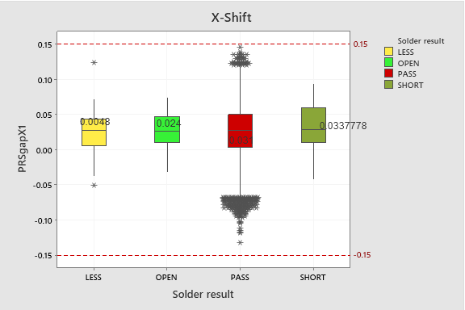
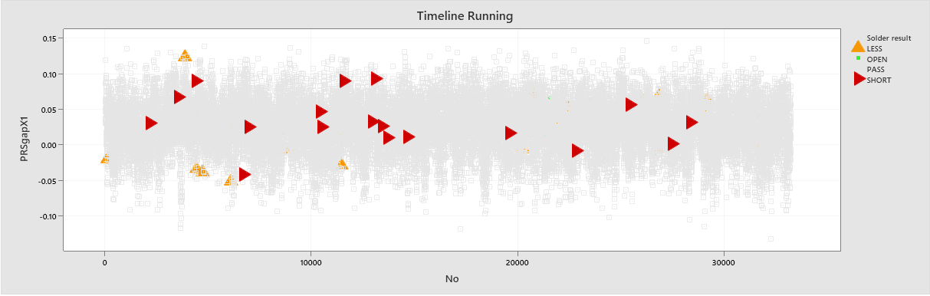
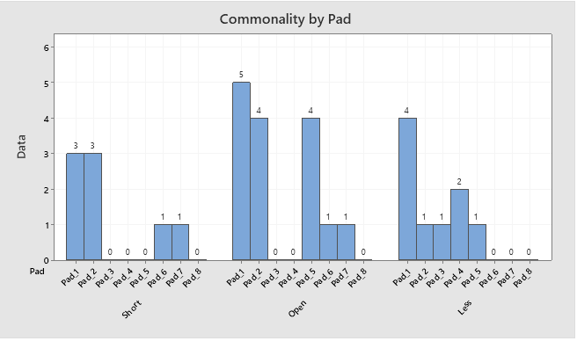
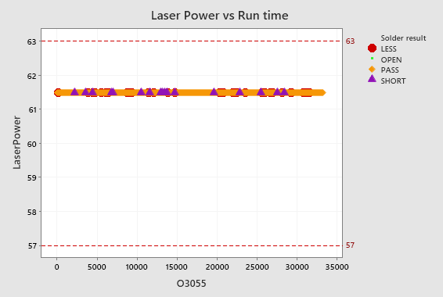
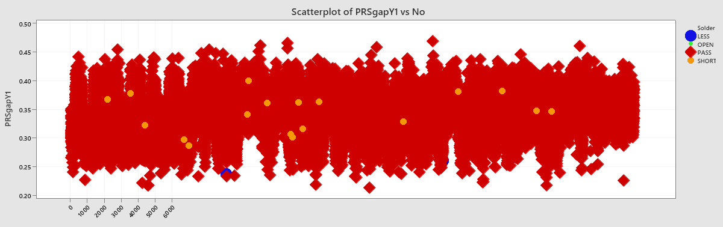
[DX] Automation analysis logfile.
Team: NPI 1
Ideas: Automation analysis logfile at Jet Soldering process.
Method: Robots will automatically load and process data instead of humans
■ Requester: Dang Phuc Thanh VH010396
■ Implementer: Dang Phuc Thanh VH010396
■ Completion Date: July/2022
Create a program automatically analysis data from Logfile to verify process capability of Jet Soldering machine and reduce time to make report.
DX Level
Digitizing | Automation | Intelligence
 | O
Before
Improvement
After
Repetitive work
Replace repetitive task
Quantitative effect
Everyday, Engineer need to download logfile from LAS and analysis data by Minitab for each machines at Jet Soldering process.
Create a program can auto analysis logfile by python.
510m
Reduce 493 min
(96%)
Pre-improvement process
Post-improvement process
17m
Log in LAS
Log in LAS
 | Before | After
Total working time | 510 mins | 17 mins
Select information (date, area, process,#…)
Select information (date, area, process,#…)
Download Logfile
Download Logfile
- Total week saved time: 2,465 mins
- Total year saved time:
= 2465/60 x 51weeks = 2,095h
- Total yearly saved money:
= saved time x labor cost per hour
= 2,095 * 102,000 = 213,690,000 VND/year
Analysis logfile by manual
Auto analysis logfile
*Take 30 mins to sorting and analysis data
*Take 1 min to sorting and analysis data
Copy and input data to Minitab
Copy and input data to Minitab
Out-put data
Qualitative effect
- Eliminate human error & increase
reliability
- Reduce workload, increase quality report
- In the future, continue apply for others process.
Grade A
Grade S3
Grade S2
Grade S1

